Slide 1
Replies to Image Recognition Technical Assessment queries
Muktabh Mayank Srivastava,
Chief Data Scientist,
ParallelDots Inc.

Slide 2
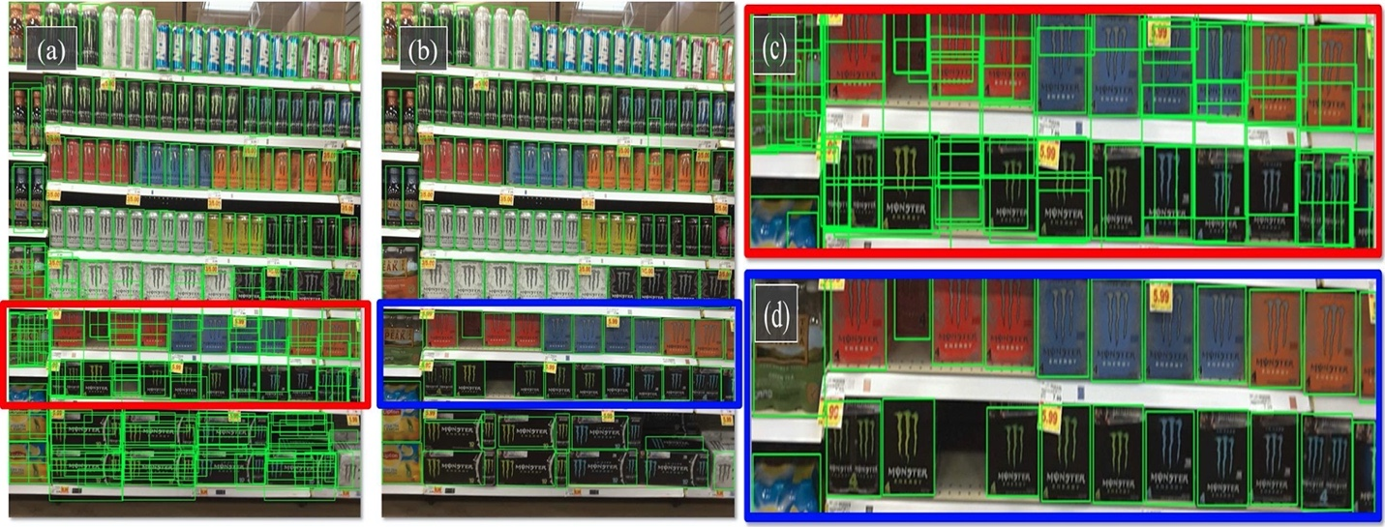

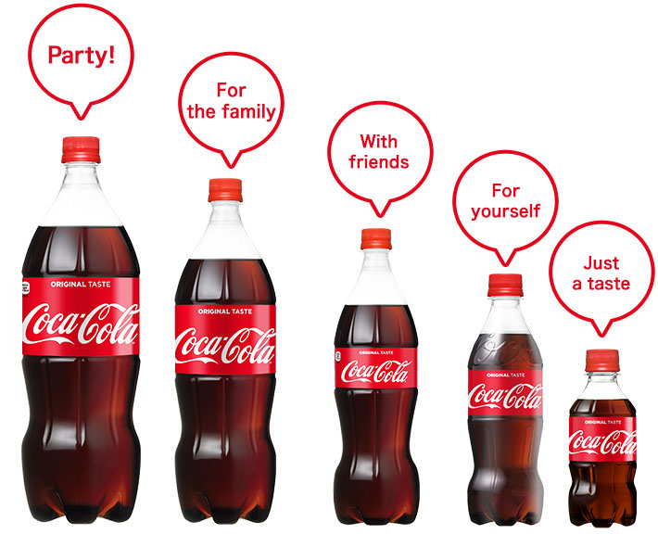
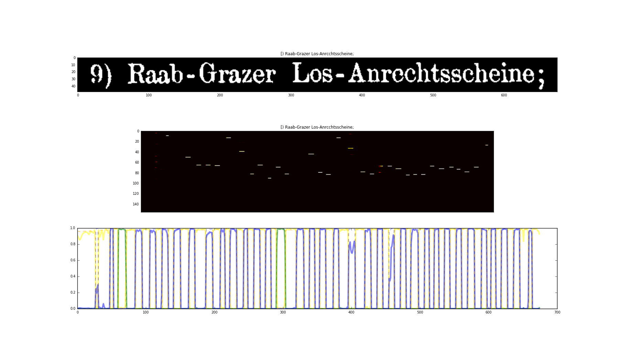
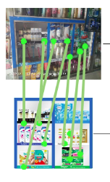
What computer vision models or algorithms does your IR solution use? Are they pre-trained or custom trained for retail environments?
Shelfwatch isn’t one algorithm, but an exhaustive Chinese menu of multiple algorithms, which are used to create a system addressing full use case. Multiple algorithms like SKU Extractor, PoP Extractor, price tag extractor, SKU identifier, PoP Identifier, SKU size variant identifier, OCR module all work in tandem.
Most of the extractor algorithms are CNNs while most identifiers are transformers.
We use public neural network architectures like ViT large and RetinaNet but the weights of these models are finetuned on our large inhouse retail datasets creating our proprietary foundation models.
The recipes of how to create these foundation models have been published at prestigious AI conferences. Our current extractor models are based on our BMVC2020 publication https://www.bmvc2020-conference.com/conference/papers/paper_0368.html and identification models are based on our VISAPP 2024 publication https://www.scitepress.org/PublishedPapers/2024/125760/
Product/PoSM/Tag Extractors [Dense Object Detection models]
Product / PoSM identifiers [Classification models]
Statistical Size Variant estimator
OCR to monitor prices
Image Matching to verify planograms

Slide 3
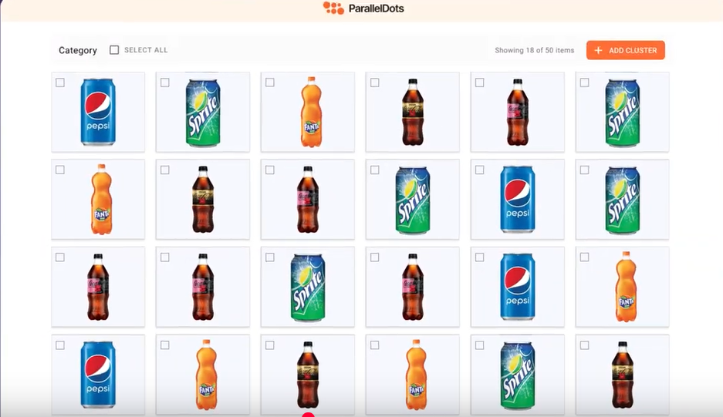
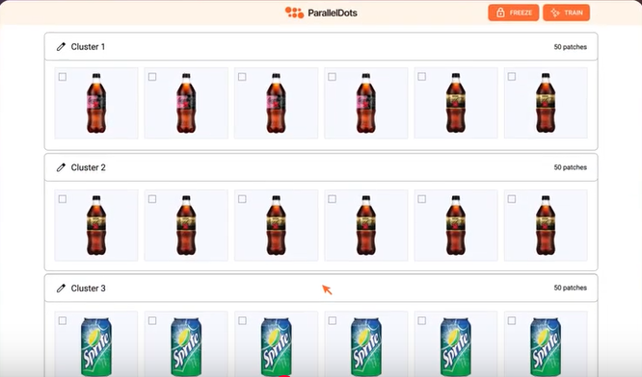
How does your system handle multi-object detection and classification in cluttered retail environments?
Detection and classification both are tasks with sizeable complexity, as shown earlier, our solution is separation of concerns using different foundation models for both.
Our extractor foundation model is dense object detector algorithm trained over 300,000+ inhouse annotated diverse images to extract products/PoSMs out of any type of complicated retail shelves. So we have very good performance day 1 onwards [early 90%]. Within a few weeks of project starting these foundation models are tuned on client’s shelf scenarios to take them to recall and precision in late 90 percentage points.
For classification, our foundation model helps us discover new products [not in our catalog] automatically due to its zero shot performance and we annotate these new product clusters and feed it back to algorithm to get accuracies in late 90 percentage points.
Automated catalog creation watch more on : https://www.youtube.com/watch?v=BYv2axifzCw

Slide 4
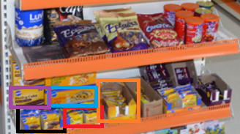
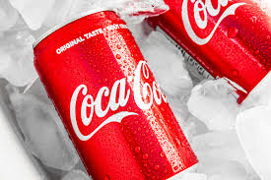
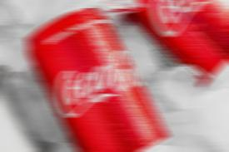
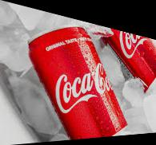
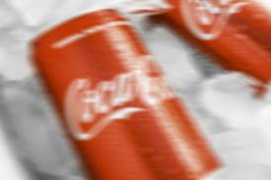
How do you handle occlusions (products blocking each other), lighting variations, and reflections in retail images? What is your system’s performance in low-light or high-glare conditions?
A simple rule of thumb is AI will do what a human would do when looking at unclear images
In case of blur, glare, lighting variations or any other distortions, if enough of the branding is retained to discriminate, the AI would try to tell an exact output, else it would fall back to making best guess [or if the client requires, move towards a surer brand level prediction]. Partial Occlusions don’t effect accuracy at all.
Occlusions are particularly tricky in case branding is totally hidden. Different clients have different strategies, like falling back at brand level prediction or using neighboring fully visible products or even letting AI take a best guess.
On lighting variations, glare & reflections, the system is much more sturdy. Foundation models have been trained on extreme augmentations on large datasets to make sure we have very high tolerance.
In occlusions where substantial amount of branding is hidden, clients will choose to either fallback to brand level outputs, or let the AI make a best guess based on neighborhood or what is visible
Extensive Augmentation at the time of training foundation model makes it sturdy to lighting, blur etc

Slide 5
If a TM, for whatever reason, adjusts the camera resolution on their iPads, would we see a decrease in model performance? If so, how much of an impact could we expect from that?
Depends upon the KPIs we are tracking. Lowering resolution effects performance when we are reading text or prices from price tags as the text gets blurred beyond recognition.
The effect is much less on product recognition. The only cases which suffer are the places where we need to read fine grained text to differentiate between product instead of branding. [This is needed sometimes in tobacco as we might need to read the text for example to differentiate two variants with different nicotine content]. We need to ensure a resolution where the text is visible.
Have never seen a POSM recognition project where accuracy gets effected due to image recognition as these are large objects. **

